Slide 1
Mineral Properties to Identify Minerals

Slide 2
Learning Objectives
I can describe physical properties used to identify minerals.
I can use physical properties to identify minerals.

Slide 3
Physical Properties of Minerals: Used for Identification (I.D.)
Color
Streak
Hardness
Cleavage
Fracture
Luster
Density

Slide 4
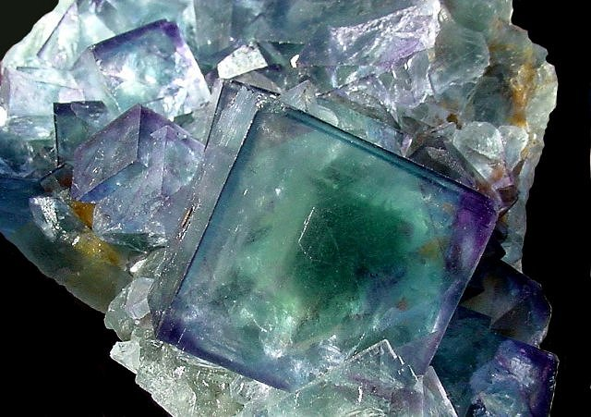
Color
First impression
Not very reliable because lots of minerals can occur in many different colors

Slide 5
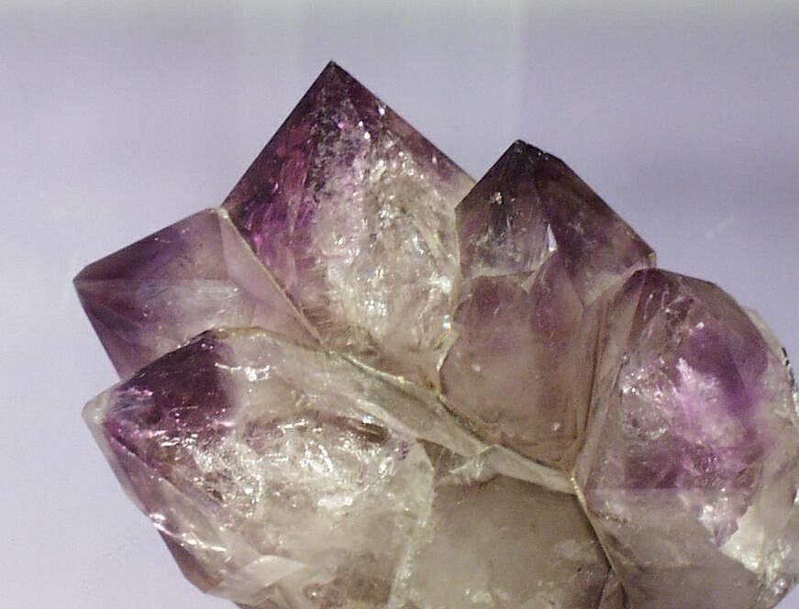
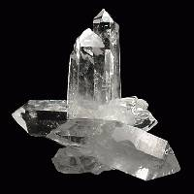
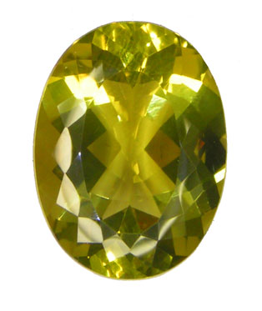
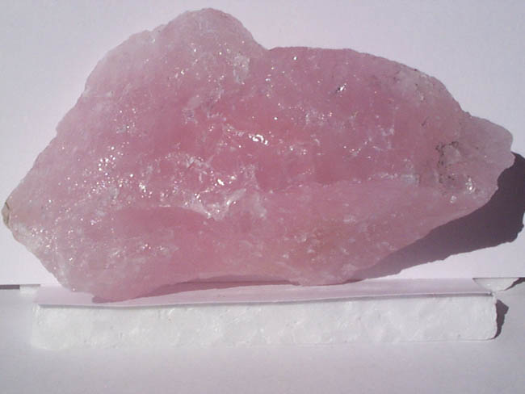
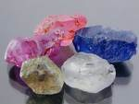
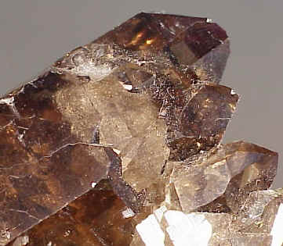
Quartz
Purple Amethyst

Slide 6
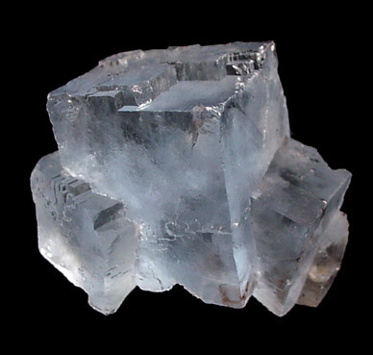
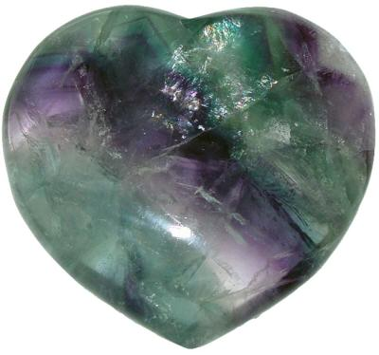
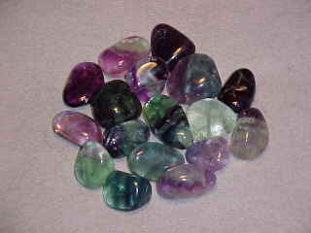
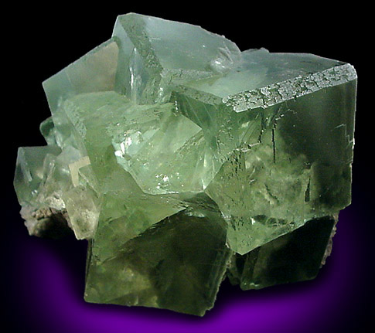
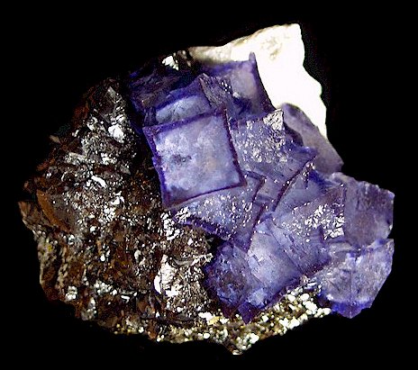
Fluorite
Clear
Blue
Green
Purple

Slide 7
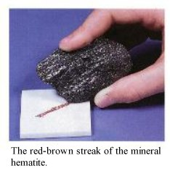
Streak
The TRUE color of a mineral
Color of a mineral’s powder
Minerals with a hardness greater than “7” usually don’t create a streak on the streak plate because they are harder than the Porcelain tile (unless the streak plate is specially made).

Slide 8
Hardness
A mineral’s resistance to being scratched
Mohs Hardness Scale from 1-10
Hardness depends on how “tightly packed” the atoms are

Slide 9
Mohs Hardness Scale
Softest
Talc
Gypsum
Calcite
Fluorite
Apatite
Potassium feldspar
Quartz
Topaz
Corundum
Diamond
Hardest

Slide 11
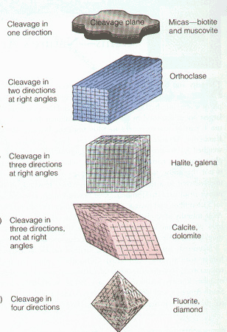
Cleavage
Splits along definite planes

Slide 12
“Cleav” = to split
Cleavage
Cleaver

Slide 14
Fracture
Breaks irregularly, jagged edges

Slide 15
Fracture Examples

Slide 16
Luster
How light shines off a mineral
Metallic or Nonmetallic

Slide 17
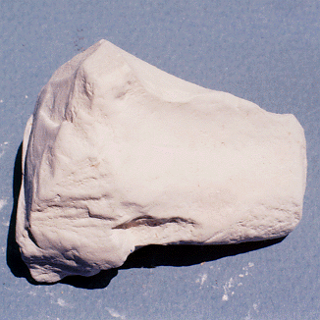
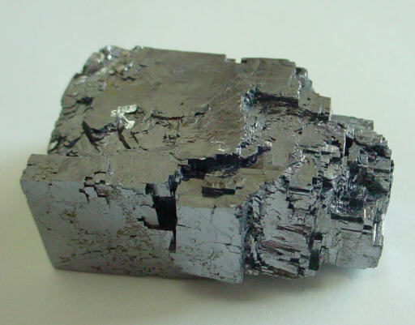
Luster Examples
Metallic
Nonmetallic

Slide 18
Density
The ratio of an objects mass to its volume
Good to use to identify as most minerals do not have the same density

Slide 19
Special Properties
Magnetism
Double Refraction
Fluorescence
Phosphorescence
Piezoelectric
Acid Test

Slide 20
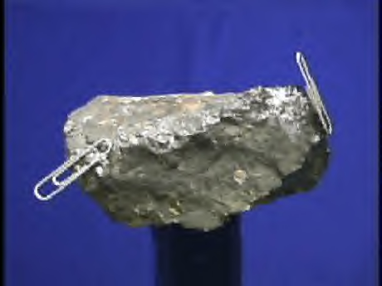
Magnetism
Attracted to a magnet
Contains IRON, cobalt, or nickel

Slide 21
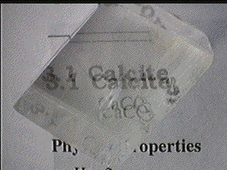
Double Refraction
Looking through it, you see “double”
Ex. Calcite

Slide 22
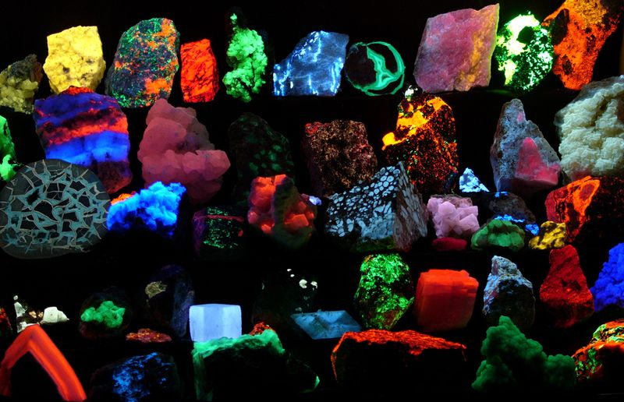
Fluorescence
Glows under ultraviolet (UV) light

Slide 23
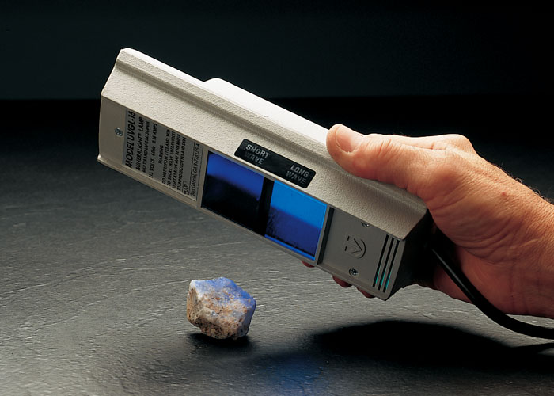
Fluorescence under ultraviolet, UV light

Slide 24
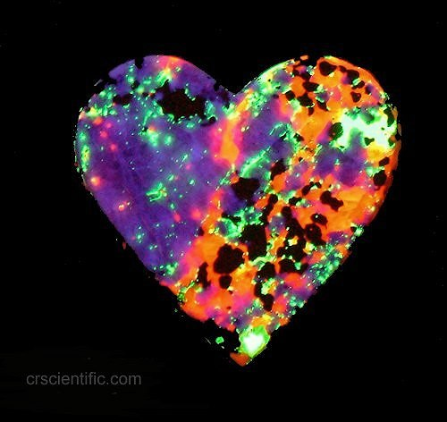
Phosphorescence
Continues to glow even after the UV light has been removed

Slide 25
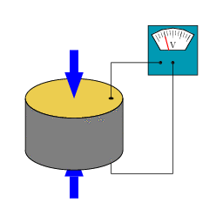
Piezoelectric (Pressure=Electricity)
Electricity is generated from Pressure
Example: Quartz

Slide 26
Acid Test
Use hydrochloric acid
Tests for carbonate (calcite)

